Slide 1
Session 2

Slide 2
Contents of sessoin
01
02
03
2D
perspectives
GD Script
Animation

Slide 3
01
2D Perspective

Slide 4
The 3 most common 2D perspectives
Side-on
Top-down
Isometric

Slide 5
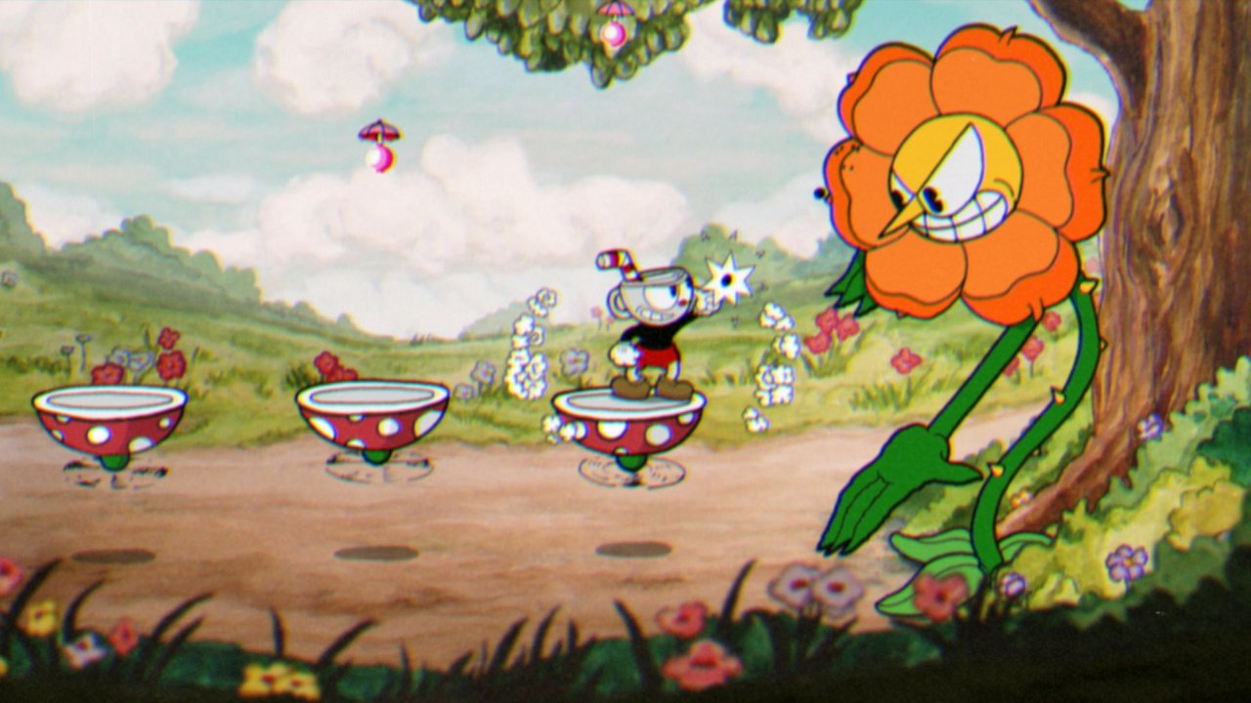
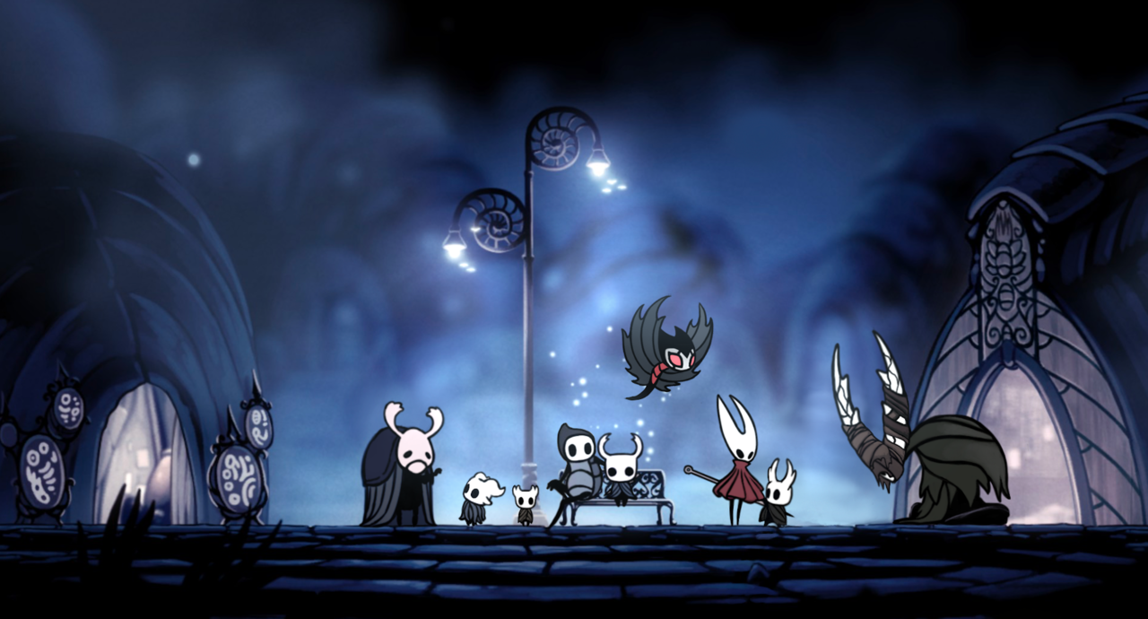
Side-on
In side-on 2D games, the view of the player is from the side and the characters move left and right, and up and down.
A popular sub-genre that features side-on 2D games is platform games, where the player often jumps from one platform to another to reach specific location or to solve a puzzle. A popular example for this is Super Mario Bros.

Slide 6
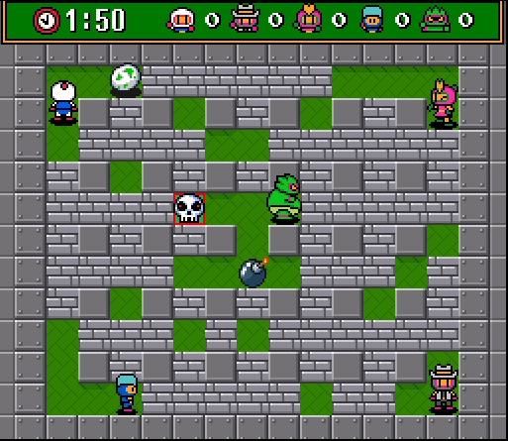
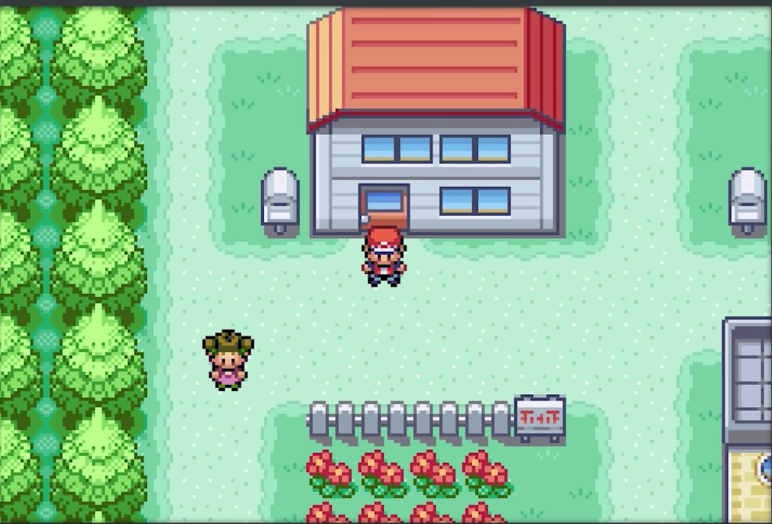
Top-down
In top-down games, the view of the player is from a bird-eye perspective, where everything is shown from the top. The player can move right and left, and forward and backwards.
Some popular examples are the classic pokemon games, Bomberman, and more recently undertale.

Slide 7
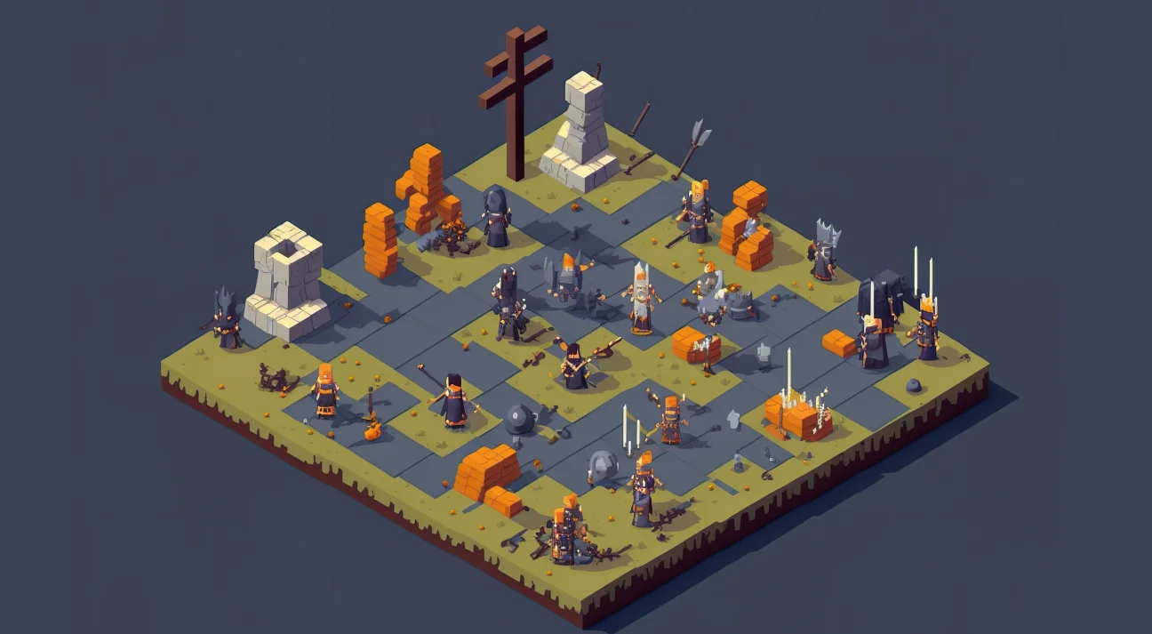
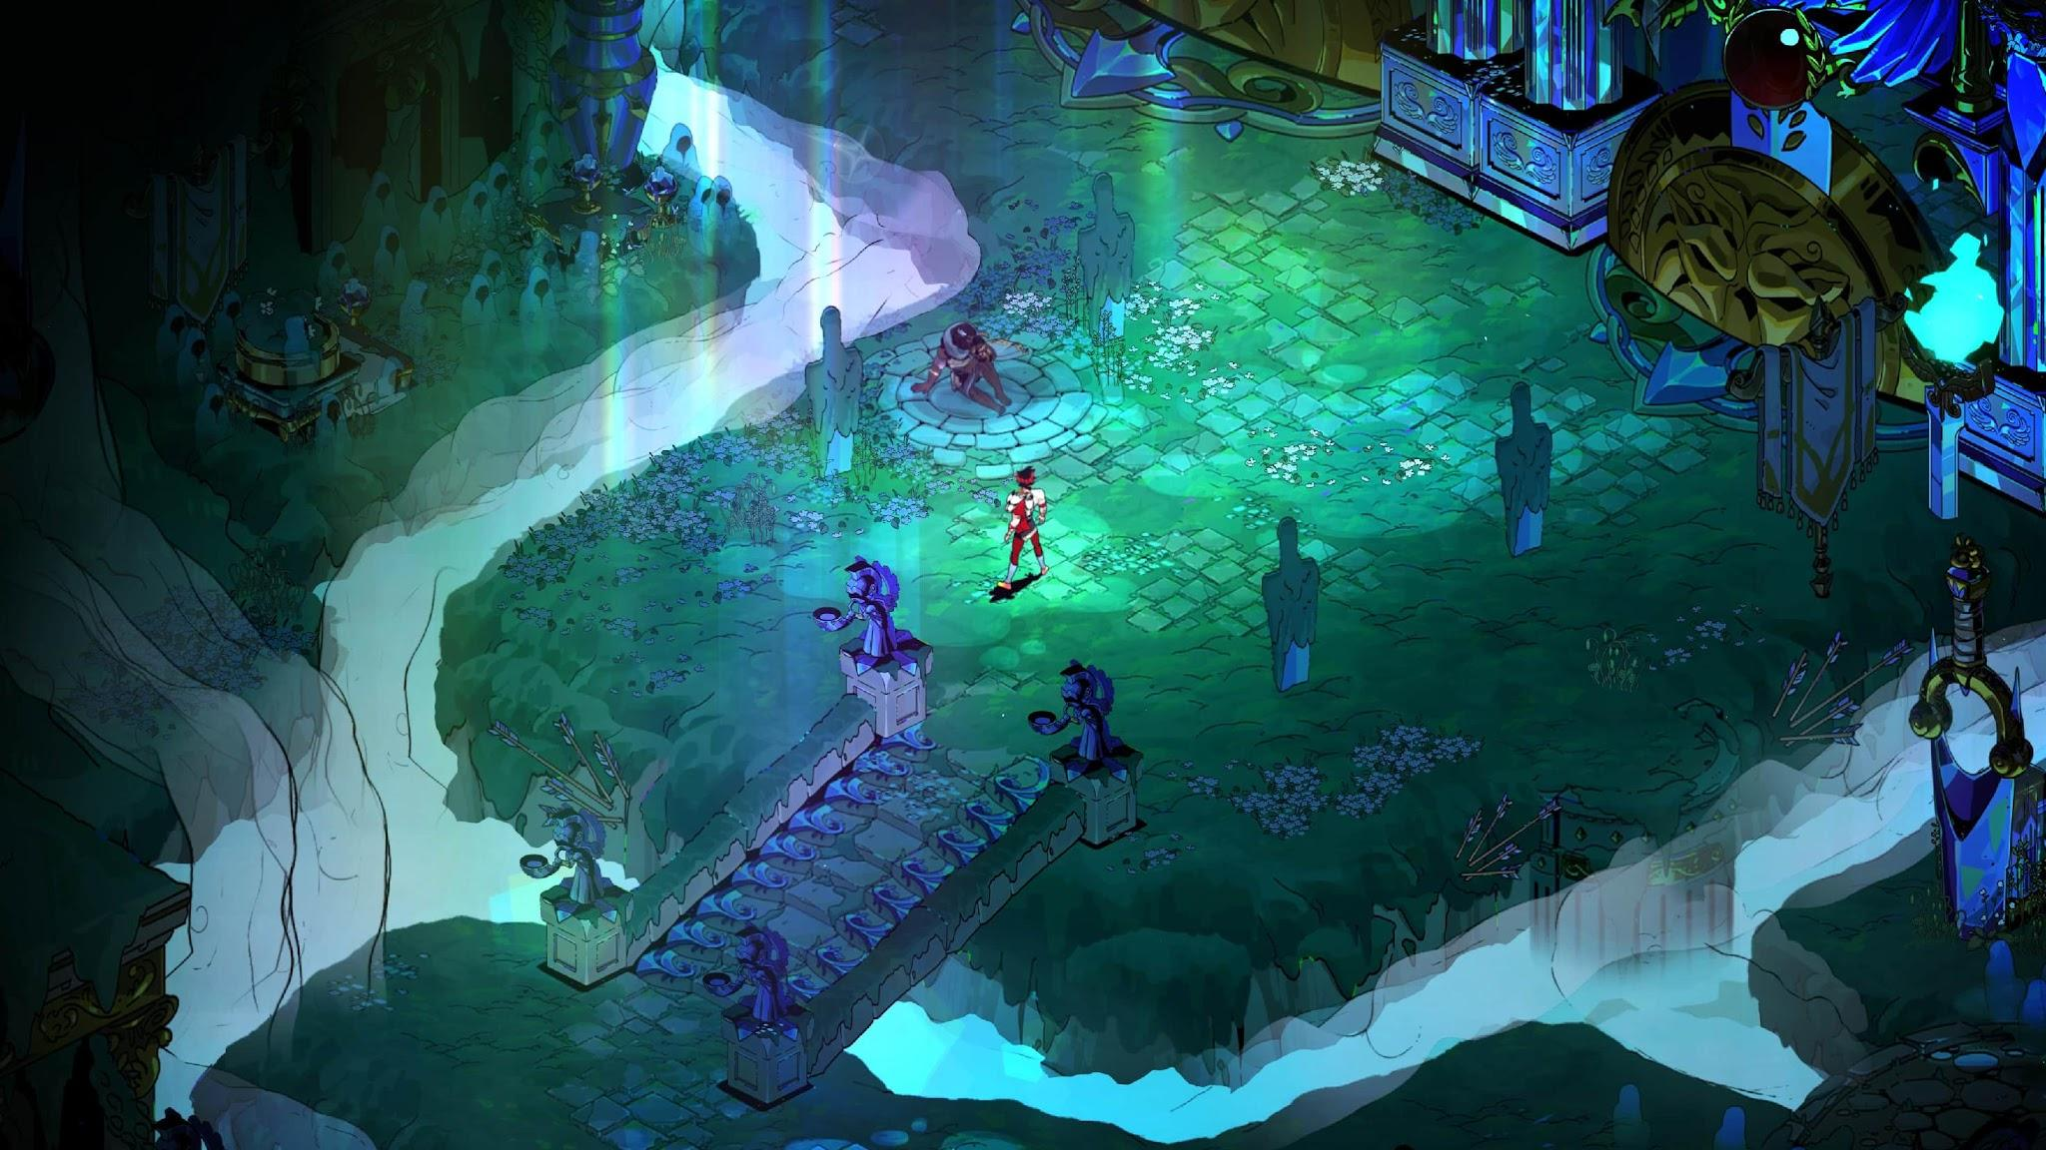
Isometric
Isometric games simulate a 3D look with only 2D graphics.
The view is usually at an angle and the player can move in different directions.
Examples of isometric games include Hades and SimCity.

Slide 8
note about Godot’s Editor
In Godot's scene editor, you can place nodes/objects in the 2-dimensional space and freely adjust their coordinates.
It's important to note that, when working with the X-axis, moving a node to the right will increase its X position value, while moving it to the left will decrease it.
Similarly, moving a node upwards will decrease its Y position value, while moving it downwards will increase it.

Slide 9
02
GD Script

Slide 10
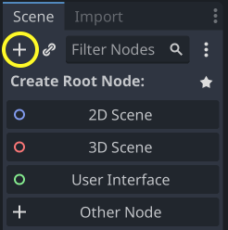
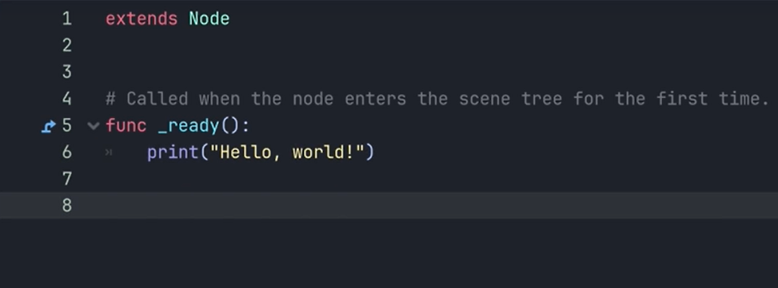
Hello World
Add A new 2d node
Attach a new script to the node

Slide 11
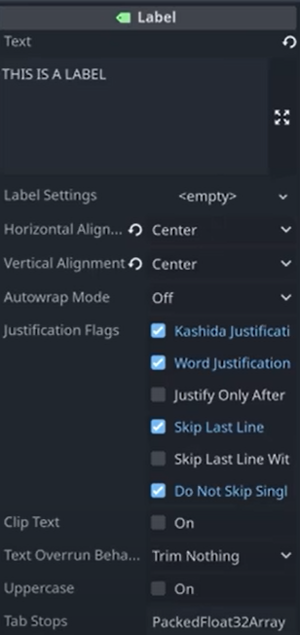
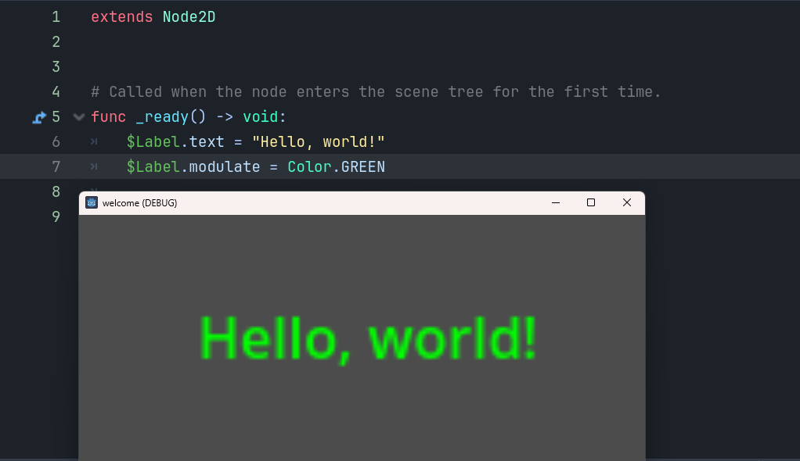
Modifying nodes
Now we’re going to edit node properties with script

Slide 12
Variables
A variable is a location in the computer’s memory where a value can be stored for use by a program
All variables declared with name and a datatype which is not necessary before they can be used in program

Slide 13
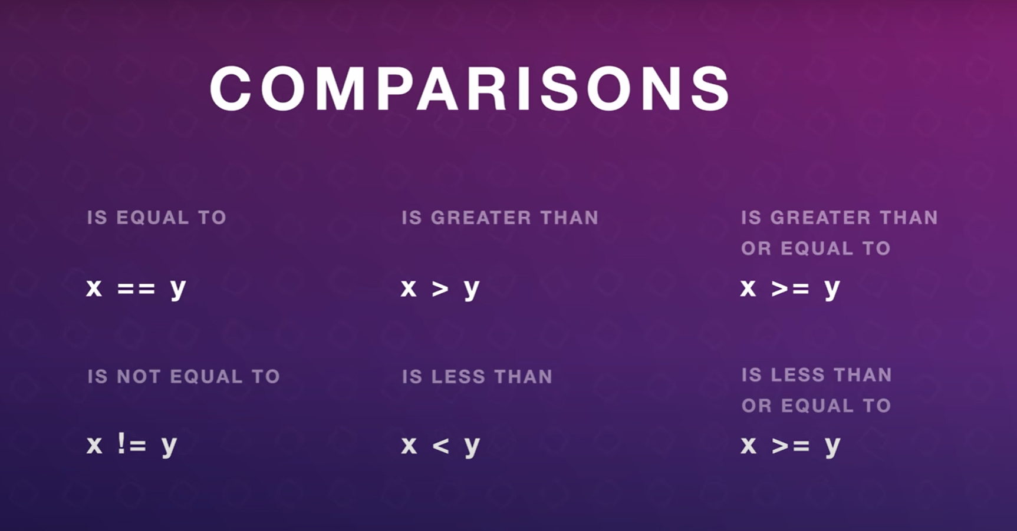
If-Statements
An if-statement checks if something is true and runs code if it is. If it's not true, it can skip the code or run something else. It helps programs make decisions

Slide 14
Functions
A function is a reusable block of code that performs a task. You call it by its name, often with inputs, and it can give back a result. Functions help organize and simplify code.

Slide 15
03
Animation

Slide 16
Animation
Animation is the process of creating a sequence of images or properties that change over time.
Animation is used to define motion, transitions and behaviors ​

Slide 17
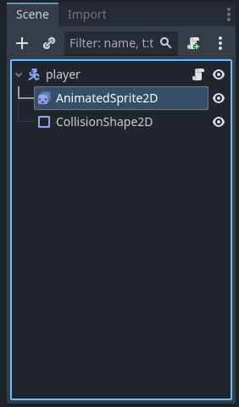
Animation
We ‘ll use the AnimatedSprite2D node​

Slide 18
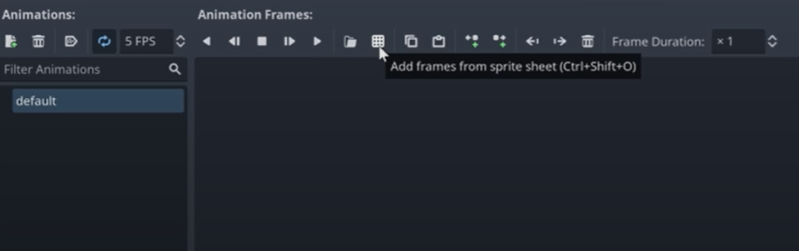
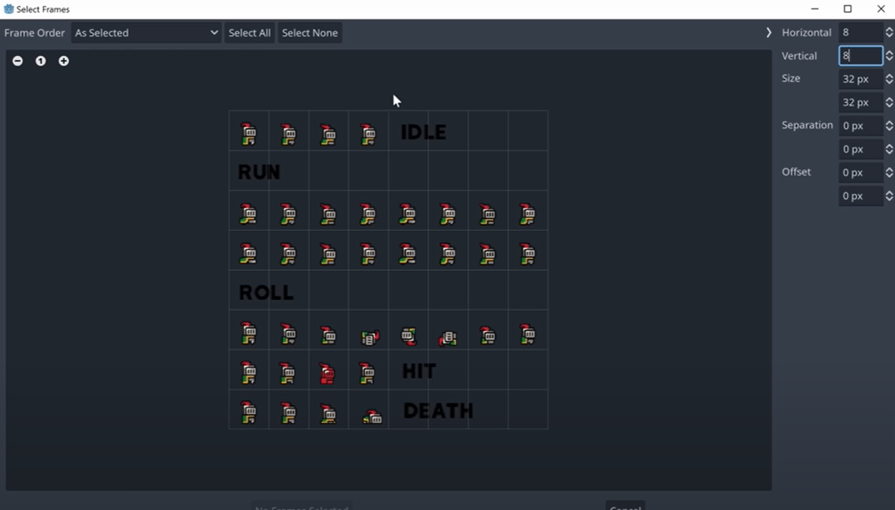
Animation
Select your sprite sheet
Adjust the size
Choose​ your animation Photos

Slide 19
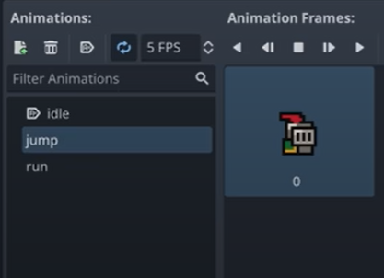
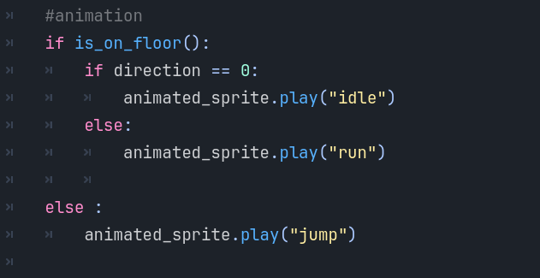
Animation
Add all Animations ( idle, jump, run, etc..)
Use (sprite.play(“your_animation”)) to change the animation according to the player movement.

Slide 20
Let’s try Making an Animated Character!

Slide 21
Hands on
• Attach a new script to your Player node.
• Define variables for movement speed and health.
• Use if statements to read input and move the player left and right.
• Add simple animation logic using AnimatedSprite2D:
– Play "run" when the player is moving.
– Play "idle" when the player is standing still.
– Play "jump" when the player is in the air.
• Run the scene and observe how movement changes the animation.

Slide 22
Thanks!
Any Questions

